Slide 1
Trex Consumer Recycling
Westchester Jewish Council Greening Committee

Slide 2
Introducing Trex: Founded on Recycling Principles
Trex Company is the world’s largest manufacturer of high- performance wood alternative decking and railing, with nearly 30 years experience
Founded in 1996, as the first company to combine the durability of recycled plastic with the natural beauty of reclaimed wood to create in a high-performance decking product
Two manufacturing plants: Virginia and Nevada
Recently announced third site in Arkansas
Employs approximately 1,600 full time employees
Sold in U.S. and internationally in 43 countries
Largest domestic recycler of polyethylene film and packaging in the US

Slide 3
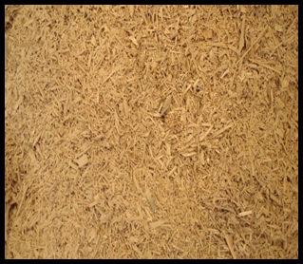
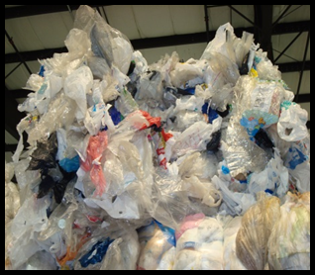
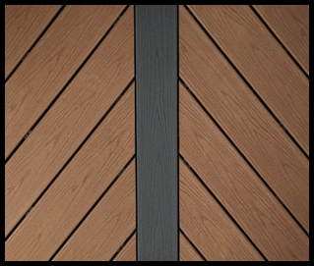
Ingredients
Trex decking boards are made from recycled polyethylene bags/wraps/films/packaging and wood waste & co-products (chips & sawdust)
The wood is a co-product (dust & chips) from flooring and cabinet manufacturers and waste from commercial/agricultural operations (pallets & tree waste)
The polyethylene film comes from various commercial and community resources
Trex upcycles 300-400 million pounds of PE every year

Slide 4
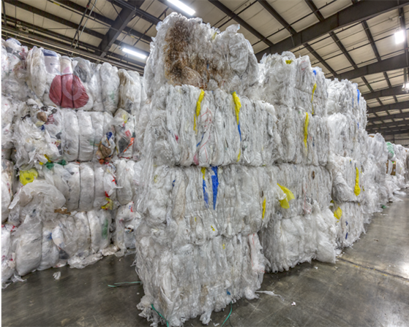
Recycling Facts
Upcycled approximately 337 million pounds of plastic film in 2022
Coordinates 3300+ school and community recycling programs
2 million pounds of plastic bags/film upcycled by Trex in 2022 through our community and school programs
NexTrex consumer program has a network of approximately 32,000 retail collection points in the U.S. and Canada

Slide 8
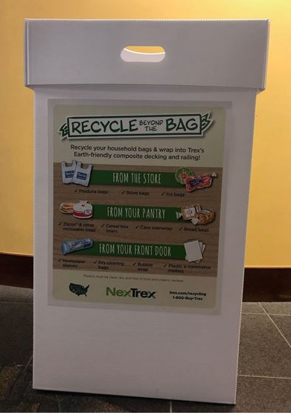

Slide 10
Website & Contact Information
https://NexTrex.com
Emily Whitacre
recycle@trex.com
540-542-6930

