Slide 1
WJC Greening Roundtable
Con Edison Incentive Program Updates
February 7th, 2024

Slide 2
Con Edison E-Mobility Programs & Initiatives Overview
EV Infrastructure Incentives
Managed Charging Incentives
Customer Education
and Support
Innovation
PowerReady
$613M for light-duty vehicles
SmartCharge NY
For residential customers
E-Mobility Advisory Services
Providing guidance prior to and during the electrification process. Offer support in understanding grid capacity at site and how to plan for upgrades
EV Charging cost calculator
Demo Projects
NYC DOT curbside charger demonstration project to install 120 plugs
RFI seeking partners to deploy cost-effect EV charging solutions for fleets
School bus
vehicle-to-grid project
MHDV Pilot
$21.5M Pilot for medium and heavy-duty vehicles
SmartCharge Commercial
For commercial charging stations
Micromobility
$18M for e-bikes
(Coming soon)
SmartCharge Load Tech
For installing load management technology
(Coming soon)

Slide 3
EV Light-Duty PowerReady Program

Slide 4
Light-Duty PowerReady Program
Incentive Overview
Project ‘cap’ is calculated on a per-plug (L2) or per-kW (DCFC) basis
 | Non-Publicly Accessible Sites | Publicly Accessible Sites
Proprietary Plugs | Up to 50% | Up to 50%
Non-Proprietary Plugs | Up to 50% | Up to 90%
Non-Proprietary & Proprietary Plugs Collocated (Equal Number of Plugs) | Up to 50% | Up to 90%
Program Overview
Program Description | Providing funding to offset customer and utility-side costs to ensure a site has adequate power to install EV chargers for light-duty vehicles. Authorized in the NY PSC 2020 Order and expanded on in November 2023
Funding | $613M
Program Dates | Start: July 2020 End: December 2025
Resources | Website Email
Program Requirements
Con Edison | Receive, or plan to receive, service from Con Edison
Plugs | L2: Minimum of 2 plugs DCFC: 6MW cap for 30+ plugs
Notes:
Provide funding to offset utility and customer-side costs to ensuring a site has adequate power to install EV chargers on commercial properties for light- duty vehicles in Con Edison service territory.

Slide 5
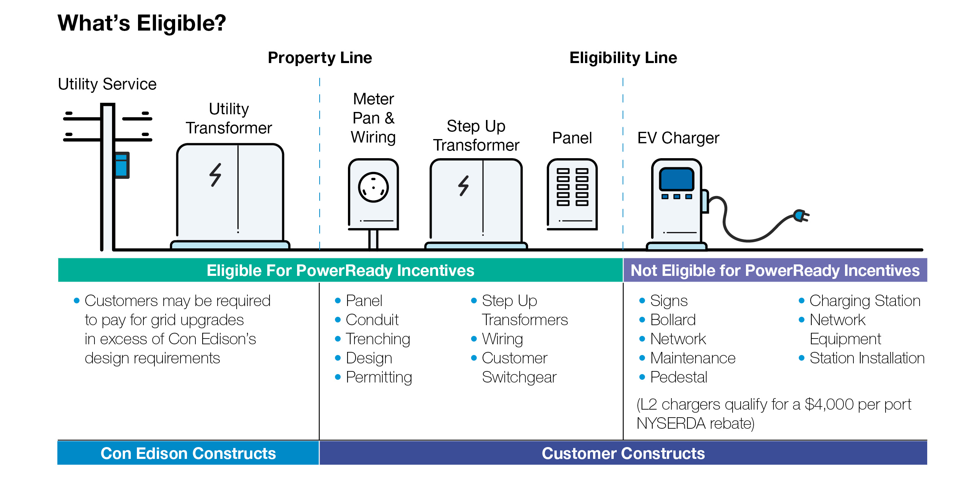
Con Edison’s PowerReady Program provides incentives for utility-side and customer-side work
L2 chargers qualify for NYSERDA funding, up to $4000

Slide 6
The tiered incentive structure provides ‘up to’ a certain level of incentive, subject to maximum ‘cap’
Project ‘cap’ is calculated on a per-plug (L2) or per-kW (DCFC) basis; details to follow
 | Non-Publicly Accessible Sites | Publicly Accessible Sites
Proprietary Plugs (e.g., CHAdeMo, Tesla) | Up to 50% | Up to 50%
Non-Proprietary Plugs (e.g., SAE J, CCS) | Up to 50% | Up to 90%
Non-Proprietary & Proprietary Plugs Collocated (Equal Number of Plugs) | Up to 50% | Up to 90%
Construction must be completed a year after Program Agreement is signed
If your project is located within a Disadvantaged Community (DAC) you may be eligible for up to 100% if any of the below conditions are met:
DCFC: Located within a disadvantaged community according to CLCPA guidance and qualify for up to 90% incentive tier.
L2 Multifamily: 25% of units must be at or below 80% of Area Median Income (AMI)
L2 Curbside: Located within a disadvantaged community according to CLCPA guidance and qualify for up to 90% incentive tier.
Publicly accessible is defined as free access to charging station by electric vehicle owners during operating hours. Municipal parking exempt from free access requirement.
Notes:
Presenter: Alison
Station size: min 2 and max 10
Stations with 2 chargers cannot make up more than 50% of the plugs
Eligible customer type (e.g. Developer, site host)
Quarterly reporting & following operational requirements

Slide 7
L2 Plug Cost Caps with Bonus Incentives
Incentive Tier | Incentive Cap for Program Eligible Costs (Customer + Potential Utility Costs; All values shown are “Up to”) |  |  |  | Future Proofing Bonus
 | Base Cost Cap | Speed Bonus | Large Project Bonus (25+ plugs) | Max Available Cost Cap | Future Proofing Bonus
Up to 50% | $5,000/plug | +$1,000/plug | +$1,500/plug (First 100 plugs) | Up to $7,500/plug | 10% of eligible costs
Up to 90% | $9,000/plug | +$1,800/plug | +$2,700/plug (First 100 plugs) | Up to $13,500/plug | 10% of eligible costs
Up to 100% | $10,000/plug | +$2,000/plug | +$3,000/plug (First 100 plugs)* | Up to $15,000/plug | 10% of eligible costs
* All Up-to-100% projects will receive the Large Project Bonus for the first 100 plugs; the 25-plug minimum is waived.
Con Edison will regularly conduct audits to ensure that costs are accurately reported Lock in incentives by signing Program Agreement!
Notes:
$100K per 150 kW DCFC plug equates to $667 per kW for DCFC
Give example: if you are installing CCS chargers at a MUD in a DAC, Con Edison will give you up to $20K to cover your eligible costs. So if your costs are $11K, Con Edison will give you $11K. If your costs are $25K, Con Edison will give you $20K. If you’re installing Tesla plugs at a mall, you’re eligible for 50%. So if your costs are $11K, we’ll give you $5.5K; if your costs are $25K, we’ll give you $10K.
The purpose of today is to go through a lot of examples, so we’ll have a chance to talk through this in more detail
L2 value is based on program data to date, this delivers maximum allowed incentives to vast majority of L2 projects
Hand back to Louisa

Slide 8
DCFC kW Cost Caps with Bonus Incentives
Incentive Tier | Incentive Cap for Program Eligible Costs (Customer + Potential Utility Costs; All values shown are “Up to”) |  |  |  |  |  | Future Proofing Bonus
 | Base Cost Cap (All Projects) | Accelerated Build Path |  |  | Charger Hub Path |  | Future Proofing Bonus
 | Base Cost Cap (All Projects) | Load Mgmt Bonus (Under Development) | Speed Bonus (Service Adequate) | Max Available Cost Cap | Interconnection Bonus (Service Inadequate/ Public & 10+) | Max Available Cost Cap
Up to 50% | $400/kW | +$25/kW | +$50/kW | Up to $475/kW | N/A | N/A | 10% of eligible costs
Up to 90% | $720/kW | +$45/kW | +$90/kW | Up to $855/kW | +$225/kW | Up to $945/kW | 10% of eligible costs
Up to 100% | $800/kW | +$50/kW | +$100/kW | Up to $950/kW | +$250/kW | Up to $1,050/kW | 10% of eligible costs
Con Edison will regularly conduct audits to ensure that costs are accurately reported Lock in incentives by signing Program Agreement!

Slide 9
Additional eligibility requirements to participate
Participant Application Submittal
Participant application: Any customer-side party (e.g., developer, site host, approved contractor) can submit the Participant application
Program agreement: The Participant that signs the program agreement takes on reporting and other responsibilities
Charger Technical Requirements
Any charger that participates in the PowerReady program must now comply with two technical standards:
All projects must utilize chargers that have hardware needed for ISO 15118 Parts 2 and 20 to get a Program Agreement
As of November 16, 2024, all new installations must utilize chargers that also have software enabled for ISO 15118 Parts 2 and 20, along with hardware needed to run OCPP 2.0.1.
Approved Contractor
Customer-side work: must be completed by an Approved Contractor
Participating Contractor Application: To become an Approved Contractor, interested entities must complete and submit a Participating Contractor Application, available at jointutilitiesofny.org
Approved Contractor Network
Application requirements include:
Company name and contact information
Check box certifying that your company is registered and maintains credentials necessary to do business in NYS.
Check box certifying that your company holds all appropriate licenses and certifications to perform EV charging station installs.
Identify utility service territories your company provides services in.

Slide 10
Additional operational requirements
Operational
& Data Reporting Period
All charging stations in the EV PowerReady Program must operate for a minimum of five years
Quarterly reporting on charging station operations required for the following 5 years
Necessary identifying information required such as “station ID” and “network ID” in order for Program to facilitate usage data collection
Public Site Accessibility
Public Site Accessibility: Free access to chargers by all EV owners during business operating hours.
Free entrance for all EV owners
Accessibility must be the same for public EV owners as tenants
Contact Information
All chargers must have easily identifiable, up-to-date contact information for the electric vehicle charger service provider displayed on each charger for EV drivers to contact if there are issues with the charger or plug
Participants must provide a contact information displayed on the chargers at project close out
DCFC Plug Operating Requirements
DCFC plugs must be operational 95 percent of the time (annually)
DCFC charging stations must be operational 99 percent of the time (annually), with a minimum of 50 percent of the plugs considered to be “up” at all times
Ownership
Ownership of EV charging stations may change, or stations may be upgraded during the five-year term, as long as the number of plugs and the capacity of the station does not decrease, and the site continues to meet all performance and reporting obligations of the Program

Slide 11
The EV PowerReady Program has a five-year quarterly reporting requirement
The Joint Utilities, including Con Edison, have selected Atlas Public Policy to be the 3rd-party data consultant Atlas will reach out to Participants & data networks at the end of each quarter to request required usage data
Data Type | Plug and Charging Session
Data below is pulled automatically based on “station ID” and “network ID” provided by the Participant during closeout
Data Requirements | Number of sessions daily Start and stop times of each charge The amount of time each vehicle is plugged in per session Peak kW per charging session kWh per charging session Plug outage information
Each PowerReady participant will be required to share data with the Joint Utilities and Department of Public Service on a quarterly basis.
Failure to provide this data could result in ineligibility for future incentives or a clawback of paid incentives
Notes:
Plug and charging session data, including:
the number of sessions daily;
start and stop times of each charge;
the amount of time each vehicle is plugged in per session;
peak kW per charging session;
kWh per charging session; and
plug outage information. Plug outage information is to include the number and duration of outages and is to be differentiated by expected outages (for maintenance) and unexpected outages.

Slide 12
PowerReady Program Process
Application
Submit Project Application
Preliminary Eligibility Review
Submit Engineering Application
Apply for Electrical Permits
Engineering Review: Service Determination
Submit Customer-side Costs
Initial Incentive Determination
Construction
Execute Program
Agreement
Initiate Customer Side Construction
Utility Side Construction & Energization
Schedule DOB/Muni Electrical Inspection
Con Edison
Verification
Participant
Work Verification (Site Visit)
Submit Final Engineering Documentation & Permits
Submit Final Invoices for Cost Review
Submit Usage Data Reporting Identifiers
Incentive Processing & Payment
Begin Data Reporting
Continued Partnership & Resources

Slide 13
SmartCharge Commercial Program

Slide 14
SmartCharge Commercial
Incentive Overview
The more you shift to overnight and off network peak, the more you earn
Peak Avoidance | Earn incentives during 4-hour network peak window with every kW avoided relative to nameplate capacity
Overnight | Earn incentives all days, year-round for charging overnight from midnight to 8 AM
Bonus | Earn incentives for public charging through early 2025
Program Overview
Program Description | Offering a predicable cash incentive revenue stream for charging during off-peak periods and overnight. Authorized in the NY PSC January 2024 Order to reduce stress on the energy grid, making service more reliable for everyone.
Funding | $227M
Program Dates | Start: January 2024
Resources | Website Email
Program Requirements
Con Edison | Receive, or plan to receive, service from Con Edison
Eligible Commercial Stations
Public Station
Workplace
Light-duty, Medium-duty, Heavy-duty fleets
Multifamily Housing
Industrial Locations
Notes:
Provide funding to offset utility and customer-side costs to ensuring a site has adequate power to install EV chargers on commercial properties for light- duty vehicles in Con Edison service territory.

Slide 15
SmartCharge Commercial Incentive Structure
Overview
L2 Charger
DCFC Charger
Earn incentives all days, year-round for charging overnight
from midnight to 8 AM
$0.03 per kWh earning while charging 12 – 8 AM
Off Peak
Earn incentives during 4-hour network peak window with every kW avoided relative to nameplate capacity
Private
$10 per kW avoided from June – September
$2 per kW avoided from October – May
Peak Avoidance*
Public
$17 per kW avoided from June– September
$6 per kW avoided from October - May
$20-26 per kW avoided from June – September
$8 per kW avoided from October – May
*Final incentive payments will be calculated based on site characteristics, load factor, and participation in DCR
Notes:
$6 per kW avoided + bonus depending on nameplate and site characteristics

Slide 16
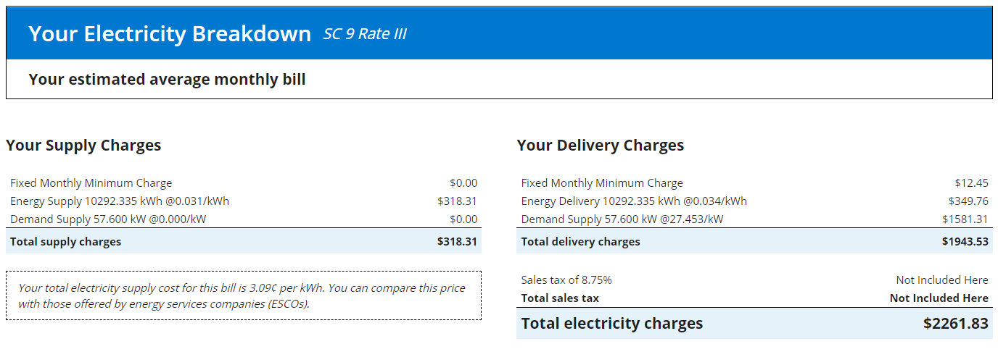
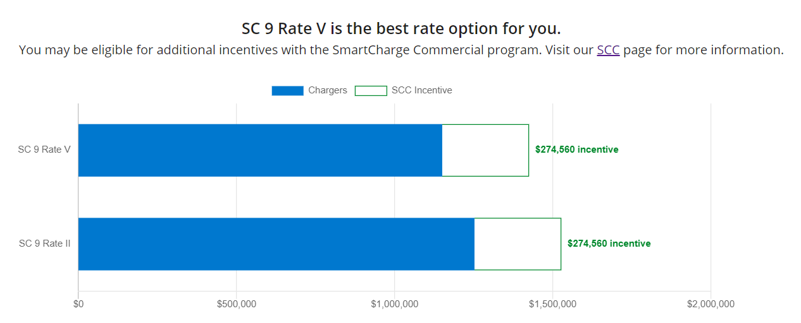
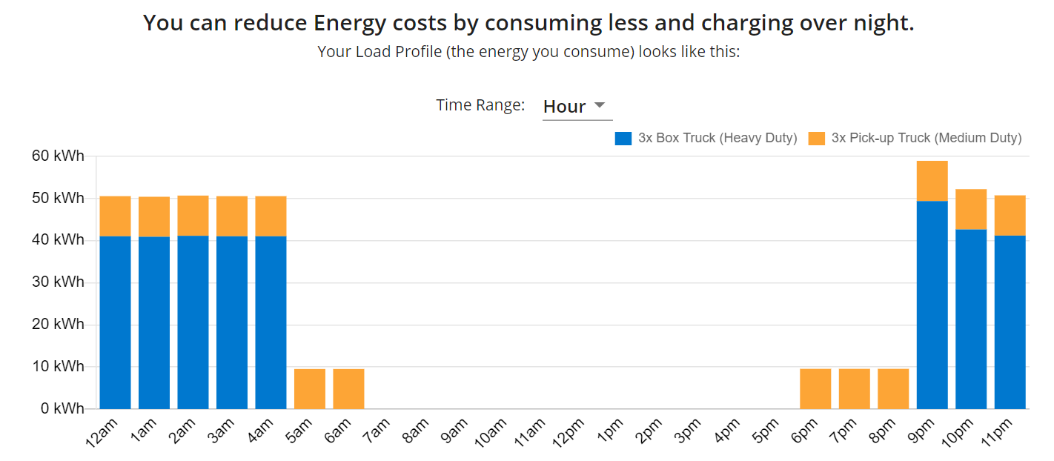
EV Charger Cost Calculator estimates SCC incentives and compares rates options
How much will my electric bill be?
EV Charger Cost Calculator
A web tool designed to help you understand the potential electric costs associated with EV charging​ as well as
potential SCC incentives.
Which rates are available, how do they compare, and how much could I earn through SCC?
Charging.coned.com
Includes directions, trainings, and one-on-one sessions to help you navigate the web tool.
How do my charger size, charging schedule and/or utilization rate impact charging costs?

Slide 17
The more you shift off network peak, the more you earn Standard Peak Avoidance – Estimated Incentives
% of nameplate capacity reduced during 4-hour peak window¹ | Charging Station Size and Associated Standard Offering Annual Incentive²³
 | Total kW based on nameplate capacity
% of nameplate capacity reached during 4-hour peak window | 100 kW |  | 500 kW |  | 1000 kW |  | 1500 kW |  | 2000 kW
 | Approximate # of L2 or DCFC Chargers
 | ~ 14 L2 Chargers OR ~1 DCFC Chargers | ~70 L2 Chargers OR ~5 DCFC Chargers | ~70 L2 Chargers OR ~5 DCFC Chargers | ~140 L2 Chargers OR ~10 DCFC Chargers | ~140 L2 Chargers OR ~10 DCFC Chargers | ~210 L2 Chargers OR ~15 DCFC Chargers | ~210 L2 Chargers OR ~15 DCFC Chargers | ~280 L2 Chargers OR ~20 DCFC Chargers | ~280 L2 Chargers OR ~20 DCFC Chargers
100% | $5,600/yr | $28,000/yr | $28,000/yr | $56,000/yr | $56,000/yr | $84,000/yr | $84,000/yr | $112,000/yr | $112,000/yr
75% | $4,200/yr | $21,000/yr | $21,000/yr | $42,000/yr | $42,000/yr | $63,000/yr | $63,000/yr | $84,000/yr | $84,000/yr
50% | $2,800/yr | $14,000/yr | $14,000/yr | $28,000/yr | $28,000/yr | $42,000/yr | $42,000/yr | $56,000/yr | $56,000/yr
25% | $1,400/yr | $7,000/yr | $7,000/yr | $14,000/yr | $14,000/yr | $21,000/yr | $21,000/yr | $28,000/yr | $28,000/yr
0% | $0/yr | $0/yr | $0/yr | $0/yr | $0/yr | $0/yr | $0/yr | $0/yr | $0/yr
See appendix for peak window by network
Does not include $0.03/kWh incentive for off-peak charging
Assuming 7.2 kW for L2 charger and 100 kW for DCFC charger

Slide 18
SCC Program Process Overview
Submit Application
Eligibility Review
Data Intake Validation
Monthly Data Intake and Calculation
Process Payment
Execute Program Agreement
Onboarding data:
Charger session or interval data:
(Need to provide either one)
Business and site details
Financial and other information for providing payment
Site host address (to confirm Con Ed account and CSRP windows)¹
Charging Site type (public, transit, fleet)
Public or private site access
15 - minute interval kW usage
15 - minute interval kWh usage
Session start and stop times
Total kWh
Charger details
Make and model of charger(s) at the Charging Site
Total L2 and DCFC charger counts
Total nameplate of all chargers on site (kW)
On site load limiting hardware (kW)
¹ Commercial System Relief Program 4-hour network peak call windows; see appendix for peak window by network

Slide 19
SmartCharge Tech Incentive Program

Slide 20
SmartCharge Tech Incentive Program to support managed charging and market development
Upcoming program pending regulatory approval
Incentive Program Details
Program Eligibility
The program will provide funding to offset costs of load management systems and battery storage to enable a site to balance and shift EV charging load.
Load control (hardware and software) technologies and battery storage are eligible for incentives
Participants are required to enroll in our SmartCharge Commercial Managed Charging program
New and existing sites are eligible, as long as the technology is newly adopted
Incentives will be stackable with other operating cost relief or incentive programs

Slide 21
Con Edison Resources

Slide 22
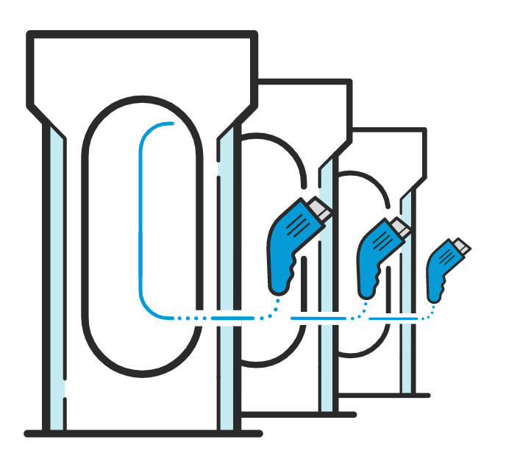
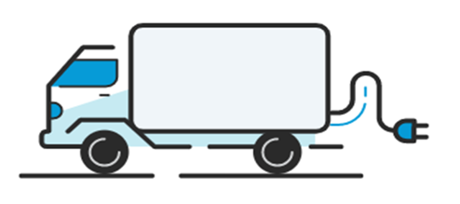
Con Edison Advisory Services available to provide guidance during electrification process
Con Edison has developed an EV Advisory Service to help you understand the grid capacity where you operate, how to plan for any upgrades that may be needed, and what electric rates may be best for you. You should engage with advisory services if you are:
A Light, Medium, Heavy Duty Fleet Operator
A Developer unsure of where to site your next project
Interested in installing a charging hub
Unsure of where to start on your EV charging journey!

Slide 23
2024 Con Edison’s networks by peak hours
11:00 AM – 3:00 PM |  | 2:00 PM – 6:00 PM |  | 4:00 PM – 8:00 PM |  | 7:00 PM – 11:00 PM
Bowling Green | Kips Bay | Battery Park City | Hudson | Buchanan | Ossining West | Crown Heights | Richmond Hill
Cortlandt | Park Place | Bay Ridge | Lenox Hill | Cedar St. | Park Slope | Randall’s Island | Ridgewood
Freedom | Pennsylvania | Beekman | Lincoln Square | Central Bronx | Prospect Park
Fulton | Plaza | Borden | Long Island City | Central Park | Rego Park
Grand Central | Sutton | Borough Hall | Madison Square | Elmsford #2 | Riverdale
Greeley Square | Times Square | Brighton Beach | Midtown West | Flatbush | Rockview
Herald Square | Turtle Bay | Canal | Millwood West | Flushing | Sheepshead Bay
Hunter |  | Chelsea | Ocean Parkway | Fordham | Southeast Bronx
 |  | City Hall | Pleasantville | Fox Hills | Sunnyside
 |  | Columbus Circle | Rockefeller Center | Fresh Kills | Wainwright
 |  | Cooper Square | Roosevelt | Granite Hill | Washington Heights
 |  | Empire | Sheridan Square | Jackson Heights | Washington St.
 |  | Fashion | Triboro | Jamaica | West Bronx
 |  | Grasslands | White Plains | Maspeth | Willowbrook
 |  | Greenwich | Williamsburg | Mohansic | Woodrow
 |  | Harlem | Yorkville | Northeast Bronx
 |  | Harrison
More detail can be found on our website: networks-and-tiers.pdf (coned.com)

Slide 24
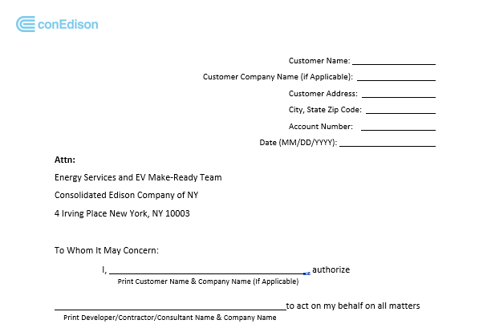
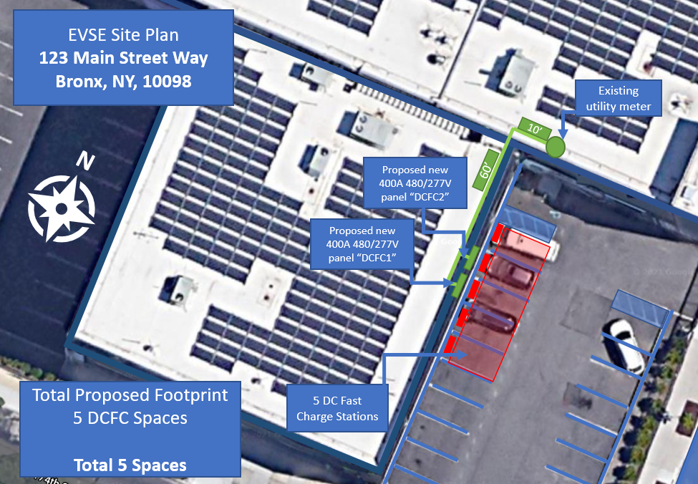
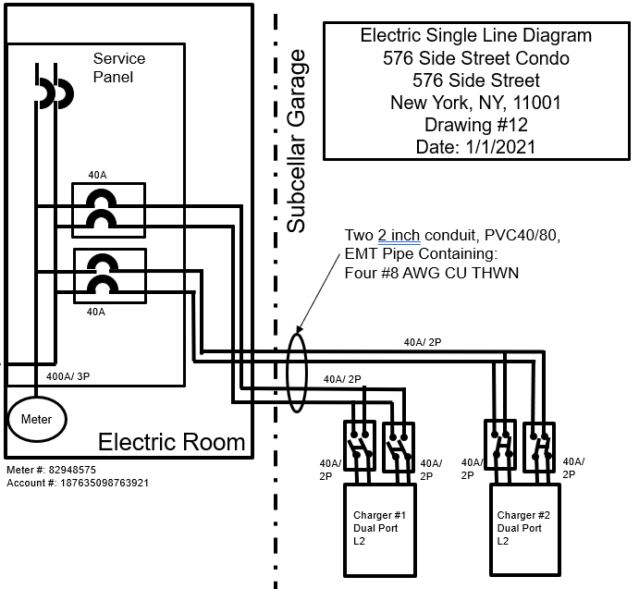
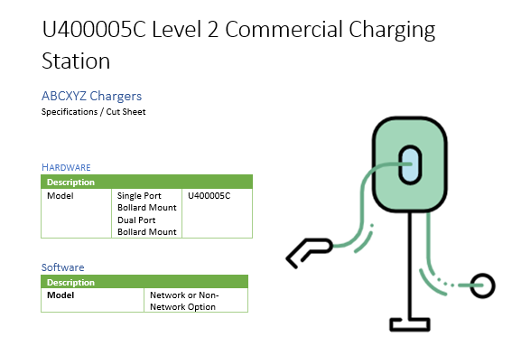
Project Center Service Application
You will need to upload the following documents in the Project Center Portal
Letter of Authorization
Site Plan
One Line Diagram
Load Letter
EV Charging Station Cut Sheet

